Slide 1



S-Match: an Algorithm and an Implementation of Semantic Matching
Pavel Shvaiko
paper with
Fausto Giunchiglia and Mikalai Yatskevich
1st European Semantic Web Symposium,
11 May 2004, Crete, Greece

Slide 2

Outline
Semantic Matching
The S-Match Algorithm
The S-Match System: Architecture and Implementation
A Comparative Evaluation
Future Work

Slide 3
Semantic Matching

Slide 4
Matching
Matching: given two graph-like structures (e.g., concept hierarchies or ontologies), produce a mapping between the nodes of the graphs that semantically correspond to each other
Matching
Syntactic Matching
Semantic Matching
Relations are computed between labels at nodes
R = {x∈[0,1]}
Relations are computed between concepts at nodes
R = { =, , , ⊥, }
Note: all previous systems are syntactic…
Note: First implementation CTXmatch [Bouquet et al. 2003 ]

Slide 5

Semantic Matching
Mapping element is a 4-tuple < ID_{ij}, n1_{i}, n2_{j}, R >, where
  ID_{ij} is a unique identifier of the given mapping element;
  n1_{i} is the i-th node of the first graph;
  n2_{j} is the j-th node of the second graph;
  R specifies a semantic relation between the concepts at the given nodes
Computed R’s, listed in the decreasing binding strength order:
        equivalence { = };
  more general/specific { , };
  mismatch { ⊥ };
    overlapping { }.
Semantic Matching: Given two graphs G1 and G2, for any node n1_{i} ∈ G1, find the strongest semantic relation R’ holding with node n2_{j} ∈ G2

Slide 6
Example: Two simple concept hierarchies
Images
Europe
?
Europe
=
?
Pictures
Wine and Cheese
?
Austria
Italy
Italy
Austria
< ID₂₂, Europe, Pictures, = >
Algo
< ID₂₁, Europe, Europe, >
⇒
< ID₂₂, Europe, Pictures, = >
Step 4
< ID₂₄, Europe, Italy, >

Slide 7
The S-Match Algorithm

Slide 8
Four Macro Steps
For all labels in T1 and T2 compute concepts at labels
For all nodes in T1 and T2 compute concepts at nodes
For all pairs of labels in T1 and T2 compute relations between concepts at labels
For all pairs of nodes in T1 and T2 compute relations between concepts at nodes
Steps 1 and 2 constitute the preprocessing phase, and are executed once and each time after the schema/ontology is changed (OFF- LINE part)
Steps 3 and 4 constitute the matching phase, and are executed every time the two schemas/ontologies are to be matched (ON - LINE part)
Given two labeled trees T1 and T2, do:

Slide 9

Step 1: compute concepts at labels
The idea:
  Translate natural language expressions into internal formal language
  Compute concepts based on possible senses of words in a label and their interrelations
Preprocessing:
  Tokenization. Labels (according to punctuation, spaces, etc.) are parsed into tokens. E.g., Wine and Cheese → <Wine, and, Cheese>;
  Lemmatization. Tokens are morphologically analyzed in order to find all their possible basic forms. E.g., Images → Image;
  Building atomic concepts. An oracle (WordNet) is used to extract senses of lemmatized tokens. E.g., Image has 8 senses, 7 as a noun and 1 as a verb;
  Building complex concepts. Prepositions, conjunctions, etc. are translated into logical connectives and used to build complex concepts
  out of the atomic concepts
  E.g., C_{Wine and Cheese} = <Wine, U(WN_{Wine})> <Cheese, U(WN_{Cheese})>

Slide 10
Step 2: compute concepts at nodes
The idea: extend concepts at labels by capturing the knowledge residing in a structure of a graph in order to define a context in which the given concept at a label occurs
Computation: Concept at a node for some node n is computed as an intersection of concepts at labels located above the given node, including the node itself
Europe
1
Pictures
Wine and Cheese
2
3
4
5
Italy
Austria
C_{Italy} = C_{Europe} C_{Pictures} C_{Italy}

Slide 11
Step 3: compute relations between concepts at labels
The idea: Exploit a priori knowledge, e.g., lexical, domain knowledge
Strong semantics element level matchers. Extract semantic relations using oracles (WordNet):
  Equivalence: A is equivalent to B, iff there is at least 1 sense in A which is a synonym of a sense in B;
  More general: A is more general than B iff there is at least 1 sense in A that has a sense in B as hyponym or meronym;
  Less general: A is less general than B iff there is at least 1 sense in A that has a sense in B as hypernym or holonym;
  Mismatch: A mismatches with B if there are two senses (one from each) which are different hyponyms of the same synset or if they are antonyms.
Weak semantics element level matchers. String-based, sense-based, etc.:
  Prefix: net is considered to be equivalent to network;
  Expansion: P.O. is considered to be equivalent to Post Office;
  Soundex: Fausto is considered to be equivalent to Phausto.
Notes:
hyponym, subordinate, subordinate word -- (a word that is more specific than a given word)
meronym, part name -- (a word that names a part of a larger whole; "`brim' and `crown' are meronyms of `hat'")
hypernym, superordinate, superordinate word -- (a word that is more generic than a given word)
holonym, whole name -- (a word that names the whole of which a given word is a part; "`hat' is a holonym for `brim' and `crown'")
synset -- (a set of one or more synonyms)

Slide 12


Step 3: cont’d
T1
T2
Recall the example:
Results of step 3:
Images
Europe
1
1
Europe
Pictures
Wine and
Cheese
2
2
3
Austria
Italy
4
5
3
4
Italy
Austria
T1
T2
C_{Europe}
C_{Pictures}
C_{Wine}
C_{Cheese}
C_{Italy}
C_{Austria}
C_{Images}
=
C_{Europe}
=
C_{Austria}
⊥
=
C_{Italy}
=
⊥

Slide 13
Step 4: compute relations between concepts at nodes
The idea: Reduce the matching problem to a validity problem
We take the relations between concepts at labels computed in step 3 as axioms (Context) for reasoning about relations between concepts at nodes.
rel = { =, , , ⊥, }.
Construct the propositional formula
  C1_{i} = C2_{j} is translated into C1_{i} ↔ C2_{j}
  C1_{i} C2_{j} is translated into C1_{i} → C2_{j} (analogously for )
  C1_{i} ⊥ C2_{j} is translated into ¬ (C1_{i} ∧ C2_{j})
Context → rel (C1_{i}, C2_{j})
A propositional formula is valid iff its negation is unsatisfiable
SAT deciders are sound and complete…

Slide 14

Step 4: cont’d
Example
Example. Suppose we want to check if C1_{Europe} = C2_{Pictures}
(C1_{Images} ↔ C2_{Pictures}) ∧ (C1_{Europe} ↔ C2_{Europe}) → (C1_{Images} ∧ C1_{Europe}) ↔ (C2_{Europe} ∧ C2_{Pictures})
Context
C1_{Europe}
C2_{Pictures}
If a check for < , , ⊥ > fails, then overlapping is returned
T1
T2
C_{Europe}
C_{Pictures}
C_{Wine and Cheese}
C_{Italy}
C_{Austria}
C_{Images}
C_{Europe}
=
C_{Austria}
⊥
C_{Italy}
=
⊥

Slide 15
Step 4: cont’d
=
T1
T2
T1
T2
Images
Europe
Images
Europe
1
1
1
1
Europe
Pictures
Wine and
Cheese
Europe
Pictures
Wine and
Cheese
2
2
3
2
2
3
Austria
Italy
4
5
Austria
Italy
4
5
3
4
Italy
Austria
3
4
Italy
Austria
⊥
T1
T2
T1
T2
Images
Europe
Images
Europe
1
1
1
1
Europe
Pictures
Wine and
Cheese
Europe
Pictures
Wine and
Cheese
2
2
3
2
2
3
Austria
Italy
4
5
Austria
Italy
4
5
3
4
Italy
Austria
3
4
Italy
Austria

Slide 16
The S-Match System:
Architecture and Implementation

Slide 17
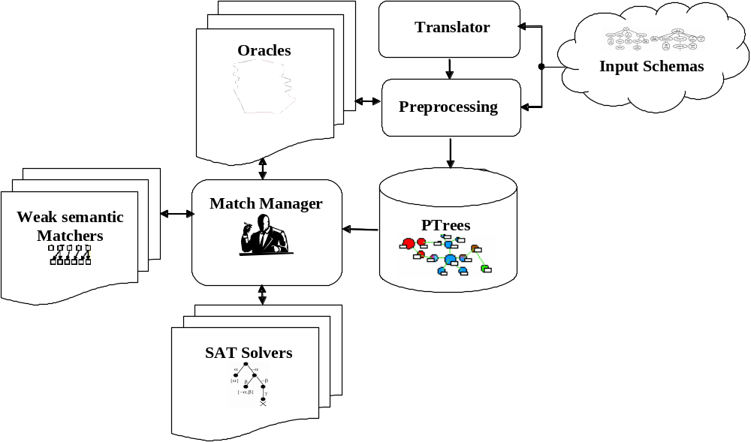
S-Match: Logical Level
NOTE: Current version of S-Match is a rationalized re-implementation of the CTXmatch system with a few added functionalities

Slide 18
S-Match: Algorithmic Level
Off-line part (Steps 1,2):
  Java WordNet Library (JWNL) 1.3
  WN 2.0 (text file or database or memory resident database)
On-line part (Steps 3,4):
  Strong semantics matchers
    WordNet 2.0
  Weak semantics matchers (12)
    String-based
    Sense-based
  Two SAT solvers (JSAT, SAT4J)

Slide 19
A Comparative Evaluation

Slide 20
Testing Methodology
Matching systems
  S-Match vs. Cupid, COMA and SF as implemented in Rondo
Measuring match quality
  Expert mappings are inherently subjective
  Two degrees of freedom
    Directionality
    Use of Oracles
  Indicators
    Precision, [0,1]
    Recall, [0,1]
    Overall, [-1,1]
    F-measure, [0,1]
    Time, sec.

Slide 21
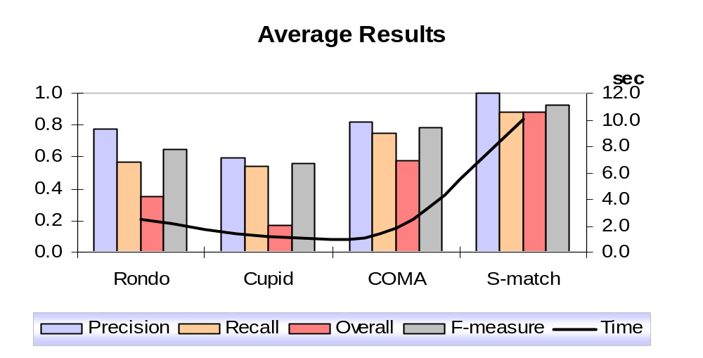
Preliminary Experimental Results
Three experiments, test cases from different domains
Some characteristics of test cases: #nodes 4-39, depth 2-3
PC: PIV 1,7Ghz; 256Mb. RAM; Win XP

Slide 22
Future Work
Extend the semantic matching approach to allow handling graphs
Extend the semantic matching algorithm for computing mappings between graphs
Develop a theory of iterative semantic matching
Elaborate results filtering strategies according to the binding strength of the resulting mappings
Optimize the algorithm and its implementation
Develop GUI to make the system interactive
Extend libraries
Develop semantic matching testing methodology
Do throught testing of the system

Slide 23
References
Project website - ACCORD: http://www.dit.unitn.it/~accord/
F. Giunchiglia, P.Shvaiko, M. Yatskevich: S-Match: an algorithm and an implementation of semantic matching. In Proceedings of ESWS’04.
F. Giunchiglia, P.Shvaiko: Semantic matching. To appear in The Knowledge Engineering Review journal, 18(3) 2004. Short versions in Proceedings of SI workshop at ISWC’03 and ODS workshop at IJCAI’03.
P. Bouquet, L. Serafini, S. Zanobini: Semantic coordination: a new approach and an application. In Proceedings of ISWC’03.
F. Giunchiglia, I. Zaihrayeu: Making peer databases interact – a vision for an architecture supporting data coordination. In Proceedings of CIA’02.
C. Ghidini, F. Giunchiglia: Local models semantics, or contextual reasoning = locality + compatibility. Artificial Intelligence journal, 127(3):221-259, 2001.

Slide 24
Thank you!

Slide 25
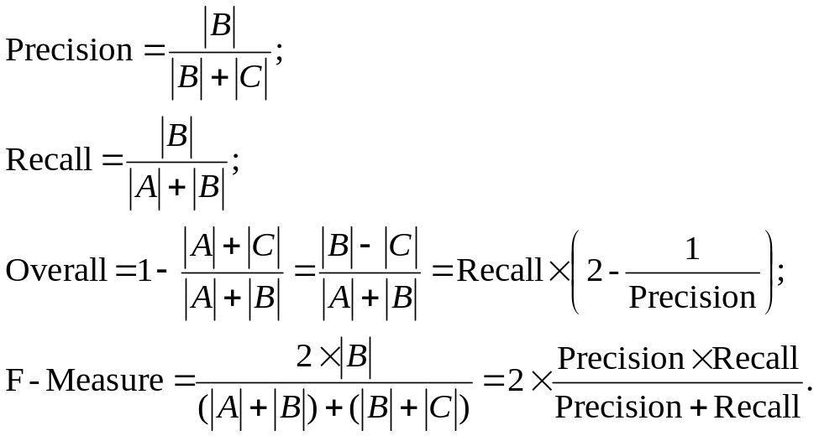
Expert Matches
System Matches
A
B
C
D
A – False negatives
B – True positives
C – False positives
D – True negatives

Slide 26
